Slide 1

CS 584 Machine Learning
Week 12
April 3, 2019

Slide 2

Week 12 Agenda
Define Neural Network
Introduce Perceptron
A Toy Example
Gradient Descent
Backpropagation Algorithm
Chapter 11 of the Machine Learning book

Slide 3
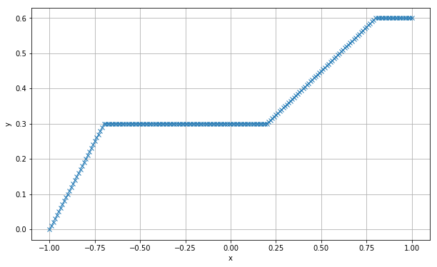
Neural Network Motivation
We observe that there is a relationship between y and x
How will you describe the relationship?
What parametric equations or functions will you use to describe the relationship?

Slide 4
Neural Network Motivation
Since we may not know the true equation, we may need to try many equations
Neural Network uses simple functions as building blocks to assemble (or estimate) the relationship
Often, there are layers of building blocks of functions

Slide 5
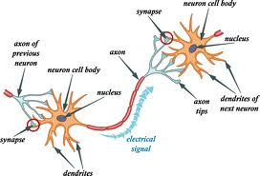
What is a Neural Network?
We should use the proper terminology Artificial Neural Network (ANN) to distinguish ours from the biological neural network
However, ANN borrows the idea from the biological neural network – an interconnected web of neurons transmitting elaborate patterns of electrical signals. Dendrites receive input signals and, based on those inputs, send an output signal via an axon.

Slide 6
Why Do We Still Say Neural Network?
We tend to abbreviate and therefore drop the "A" or the "artificial".
Most of the new models are designed for non-biological applications and users of these new models rarely in the biological field.
However, if you are a data scientist in the biological field, it is better to keep the “A” to avoid any unnecessary confusion.

Slide 7
Define Neural Network
Broadly defined, a neural network is a linkage of many simple processors ("units"), each possibly having a limited amount of local transient memory in the form of weights.
The units are connected by directional communication channels ("connections") which transmit numeric data, encoded by any of various means.
The units operate only on their local data and on the inputs they receive via the connections.

Slide 8
Introduce the Perceptron
It is a type of artificial neuron.
It is a single layer neural network.
Perceptron was developed by Frank Rosenblatt (1928 – 1971).
Principles of Neurodynamics: Perceptrons and the Theory of Brain Mechanisms, Spartan Books, 1962
In the original definition, a perceptron takes several binary inputs and produces a single binary output

Slide 9

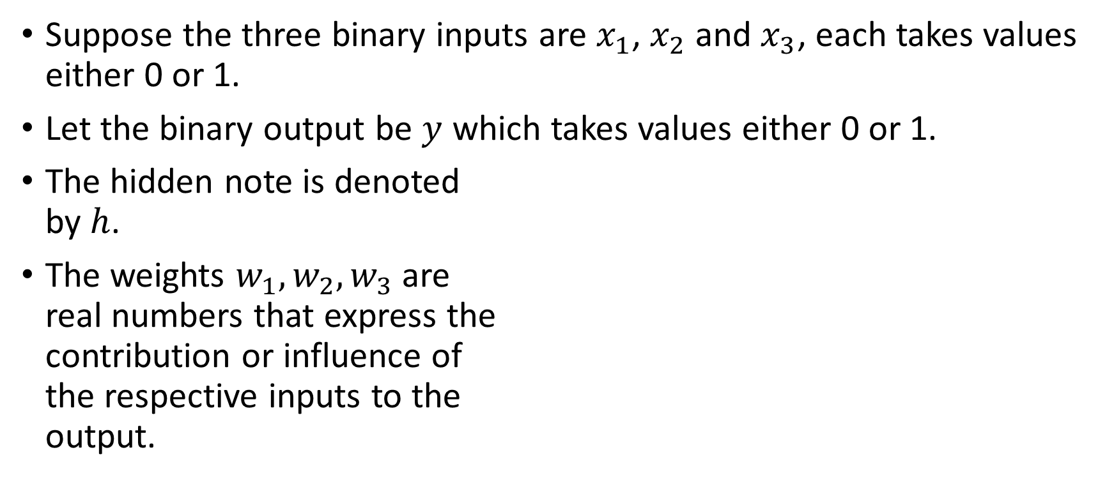







A Representation of a Perceptron
Suppose the three binary inputs are $x_{1}$, $x_{2}$ and $x_{3}$, each takes values either 0 or 1.
Let the binary output be $y$ which takes values either 0 or 1.
The hidden note is denoted by $h$.
The weights $w_{1},w_{2},w_{3}$ are real numbers that express the contribution or influence of the respective inputs to the output.
$$x_{1}$$
$$w_{1}$$
$$x_{2}$$
$$h$$
$$y$$
$$w_{2}$$
$$x_{3}$$
$$w_{3}$$

Slide 10
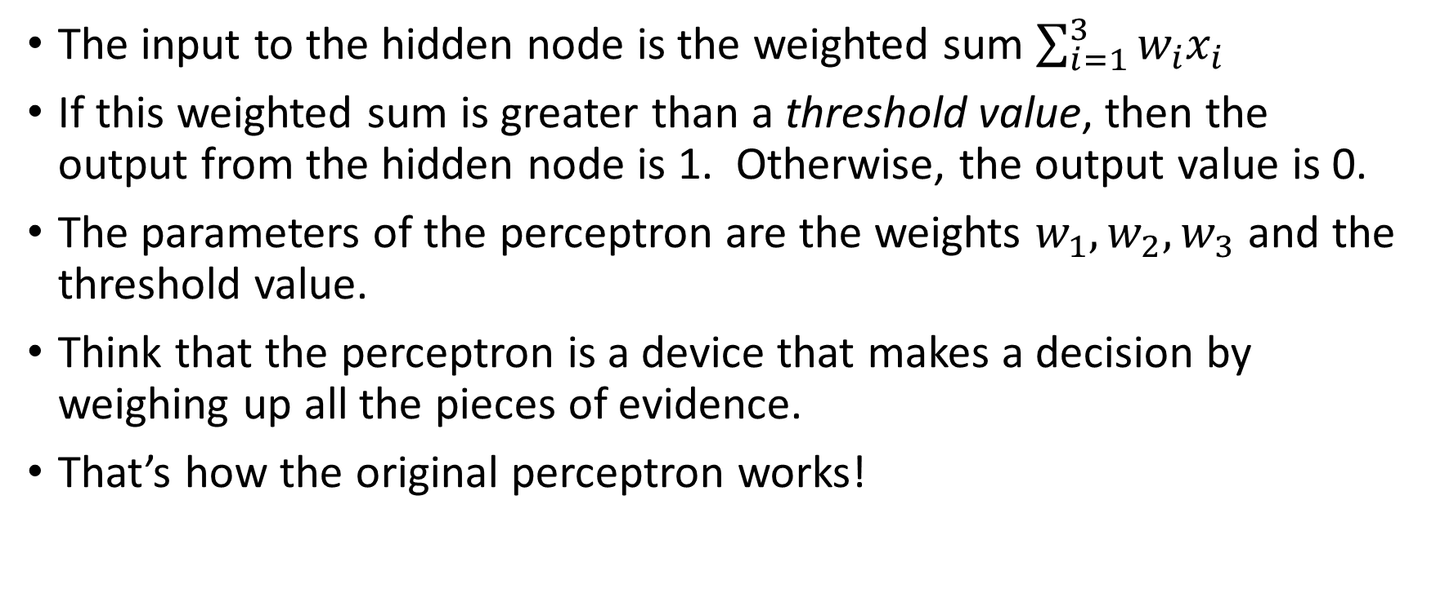
A Representation of a Perceptron
The input to the hidden node is the weighted sum $\sum_{i=1}^{3}{w_{i}x_{i}}$
If this weighted sum is greater than a threshold value, then the output from the hidden node is 1. Otherwise, the output value is 0.
The parameters of the perceptron are the weights $w_{1},w_{2},w_{3}$ and the threshold value.
Think that the perceptron is a device that makes a decision by weighing up all the pieces of evidence.
That’s how the original perceptron works!

Slide 11
An Example of the Perceptron
Suppose you need to pay for a meal that costs $6.
You have three bills in your wallet
One $1 bill
One $5 bill
One $10 bill.
How will you use these three bills to pay for the meal?

Slide 12
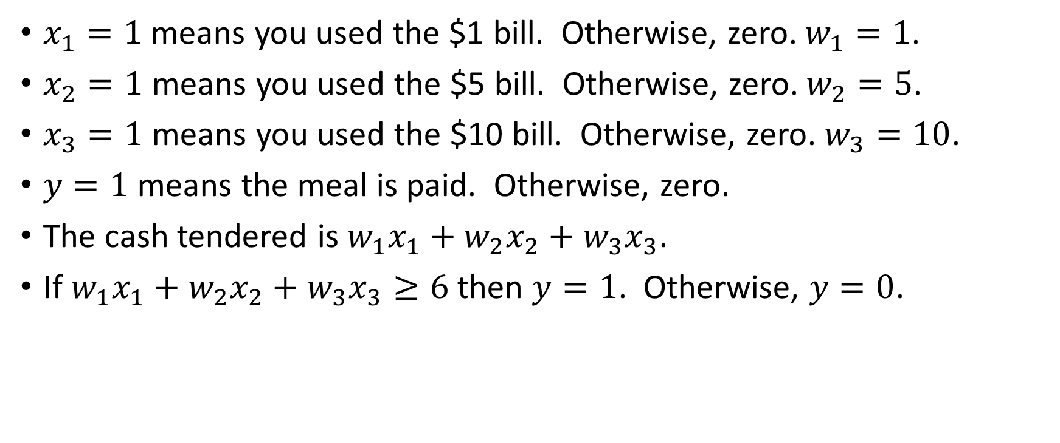
An Example of the Perceptron
$x_{1}=1$ means you used the $1 bill. Otherwise, zero. $w_{1}=1$.
$x_{2}=1$ means you used the $5 bill. Otherwise, zero. $w_{2}=5$.
$x_{3}=1$ means you used the $10 bill. Otherwise, zero. $w_{3}=10$.
$y=1$ means the meal is paid. Otherwise, zero.
The cash tendered is $w_{1}x_{1}+w_{2}x_{2}+w_{3}x_{3}$.
If $w_{1}x_{1}+w_{2}x_{2}+w_{3}x_{3}≥6$ then $y=1$. Otherwise, $y=0$.

Slide 13
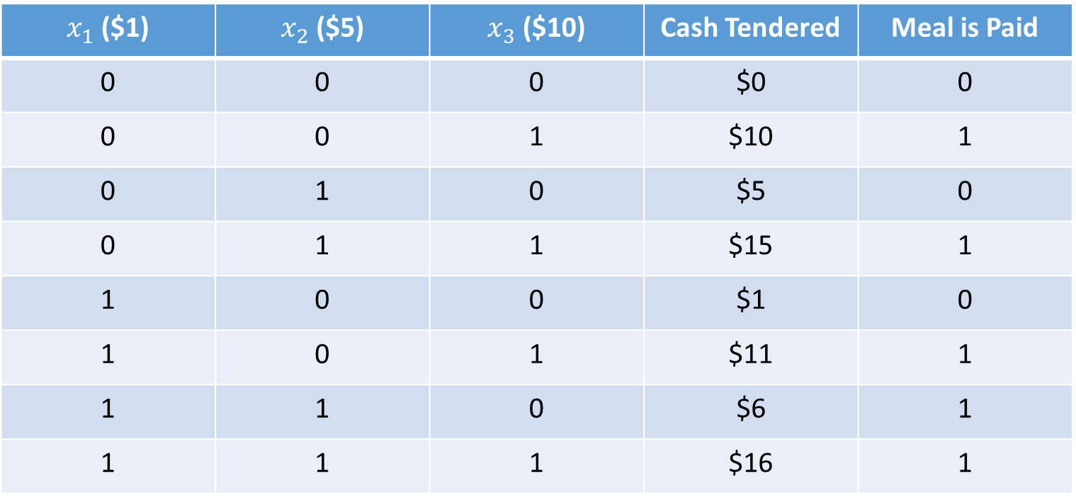
An Example of the Perceptron
$x_{1}$ ($1) | $x_{2}$ ($5) | $x_{3}$ ($10) | Cash Tendered | Meal is Paid
0 | 0 | 0 | $0 | 0
0 | 0 | 1 | $10 | 1
0 | 1 | 0 | $5 | 0
0 | 1 | 1 | $15 | 1
1 | 0 | 0 | $1 | 0
1 | 0 | 1 | $11 | 1
1 | 1 | 0 | $6 | 1
1 | 1 | 1 | $16 | 1

Slide 14
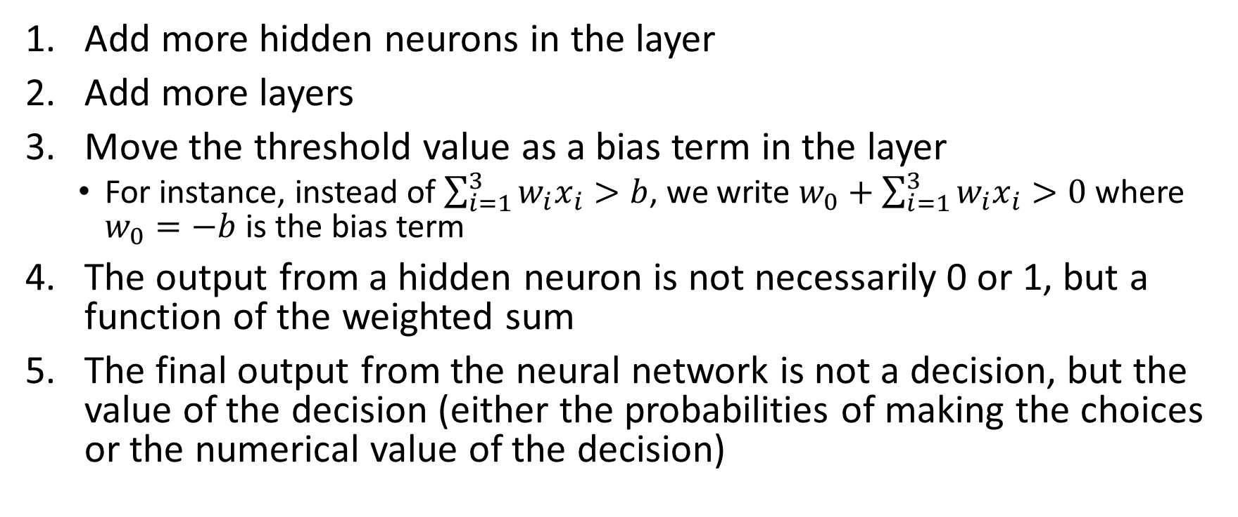
Extend and Expand the Perceptron
Add more hidden neurons in the layer
Add more layers
Move the threshold value as a bias term in the layer
For instance, instead of $\sum_{i=1}^{3}{w_{i}x_{i}>b}$, we write $w_{0}+\sum_{i=1}^{3}{w_{i}x_{i}}>0$ where $w_{0}=−b$ is the bias term
The output from a hidden neuron is not necessarily 0 or 1, but a function of the weighted sum
The final output from the neural network is not a decision, but the value of the decision (either the probabilities of making the choices or the numerical value of the decision)

Slide 15
Introduce the Multi-Layer Perceptron
Bias
Y1
H(2:0)
H(1:0)
H(3:0)
X1
H(2:1)
Y2
X2
H(1:1)
H(3:1)
H(2:2)
Y3
X3
Input Layer
Hidden Layer(s)
Output Layer

Slide 16
Structure of a Multi-Layer Perceptron (MLP)
The units are entities in the neural network diagram.
The input layer contains the input variables and the optional bias term.
Create a dummy coding unit (i.e., 0 and 1) for each category of the input variable.
The hidden layers contain unobservable units.
The value of each hidden unit is the resulting value of the activation function of the preceding units that feed into the hidden unit.
The combination function determines how information from preceding units are combined.
The output layer contains the target variables.
Create a dummy coding unit (i.e., 0 and 1) for each category of the output variable.

Slide 17
Structure of a Multi-Layer Perceptron (MLP)
The bias unit indicates the baseline input into the succeeding units. It is like the intercept term in regression.
The weights are numeric values that indicate the strength of the signal from a preceding unit to a succeeding unit.
The combination function combines weights and values of preceding units into a single value that feed into the activation function.
The activation function transforms the result of combination function into the value for the succeeding unit.

Slide 18
Structure of a Multi-Layer Perceptron (MLP)
The error function measures the discrepancy between the network output values and the observed target values.
The objective function is what you directly try to optimize in building the network.

Slide 19
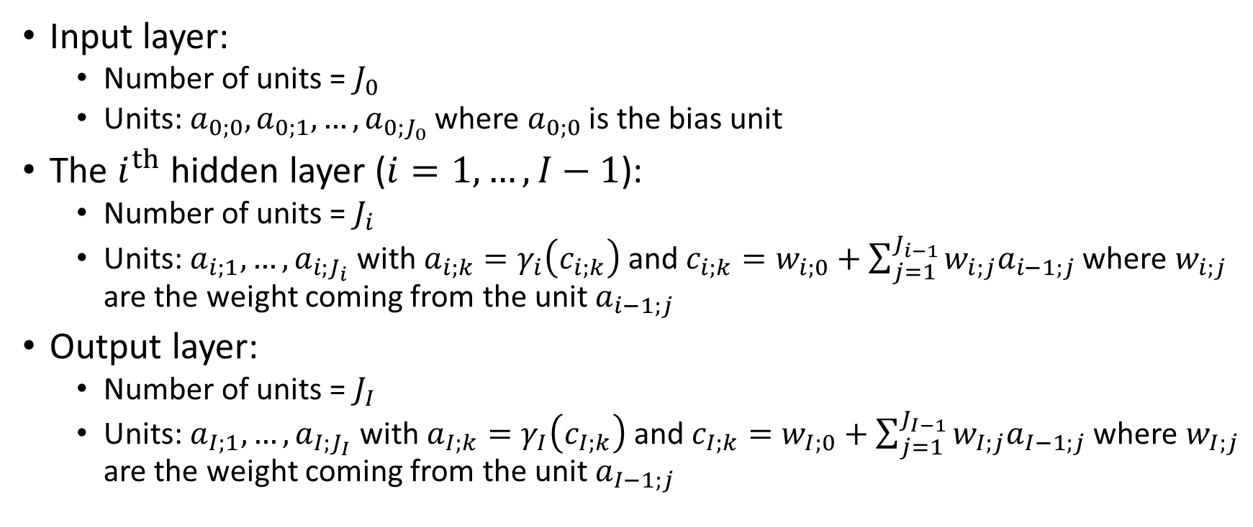
The MLP Mathematical Representation
Input layer:
Number of units = $J_{0}$
Units: ${a_{0;0},a}_{0;1},…,a_{0;J_{0}}$ where $a_{0;0}$ is the bias unit
The $i^{th}$hidden layer ($i=1,…,I−1$):
Number of units = $J_{i}$
Units: $a_{i;1},…,a_{i;J_{i}}$ with $a_{i;k}=γ_{i}\left(c_{i;k}\right)$ and $c_{i;k}=w_{i;0}+\sum_{j=1}^{J_{i−1}}{w_{i;j}a_{i−1;j}}$ where $w_{i;j}$ are the weight coming from the unit $a_{i−1;j}$
Output layer:
Number of units = $J_{I}$
Units: $a_{I;1},…,a_{I;J_{I}}$ with $a_{I;k}=γ_{I}\left(c_{I;k}\right)$ and $c_{I;k}=w_{I;0}+\sum_{j=1}^{J_{I−1}}{w_{I;j}a_{I−1;j}}$ where $w_{I;j}$ are the weight coming from the unit $a_{I−1;j}$

Slide 20
The MLP Mathematical Representation
The combination function is the inner product (i.e., the dot product) of the weights and the values of preceding units.
The bias term is not counted in the total number of units of a layer.
When there is no hidden layer (i.e., I = 1), the MLP becomes a generalized linear model where the linear regression is a special case.

Slide 21

Activation Functions for Hidden Layer
Hyperbolic Tangent
$γ\left(c\right)=tanh\left(c\right)$ $=\frac{\exp\left(c\right)−exp⁡\left(−c\right)}{\exp\left(c\right)+exp⁡\left(−c\right)}$
Logistic (a.k.a. Sigmoid)
$γ\left(c\right)=\frac{1}{1+exp\left(−c\right)}$
$tanh\left(c\right)=\frac{2}{1+exp\left(−2c\right)}−1$

Slide 22
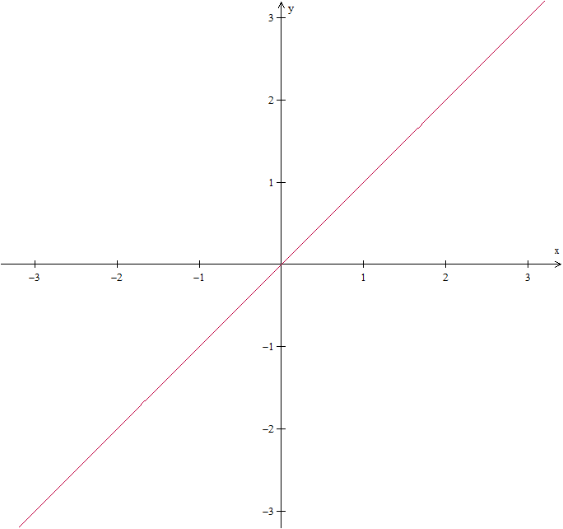
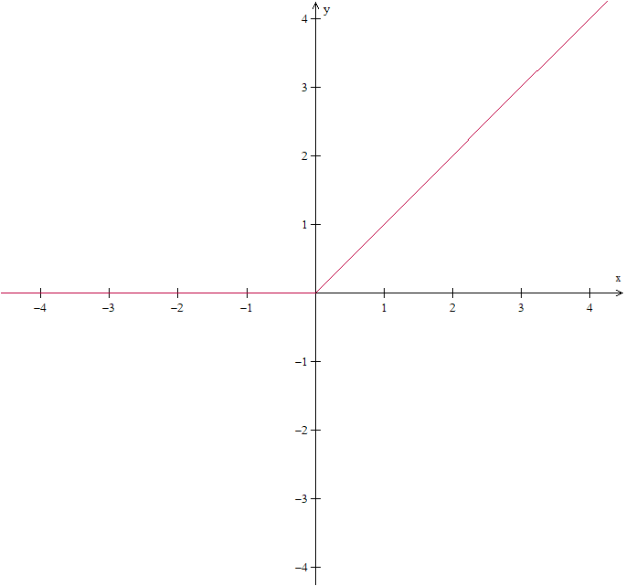

Activation Functions for Hidden Layer
Identity
$γ\left(c\right)=c$
Rectifier (ReLU)
$γ\left(c\right)=max⁡(0,c)$
ReLU = Rectifier Linear Unit

Slide 23
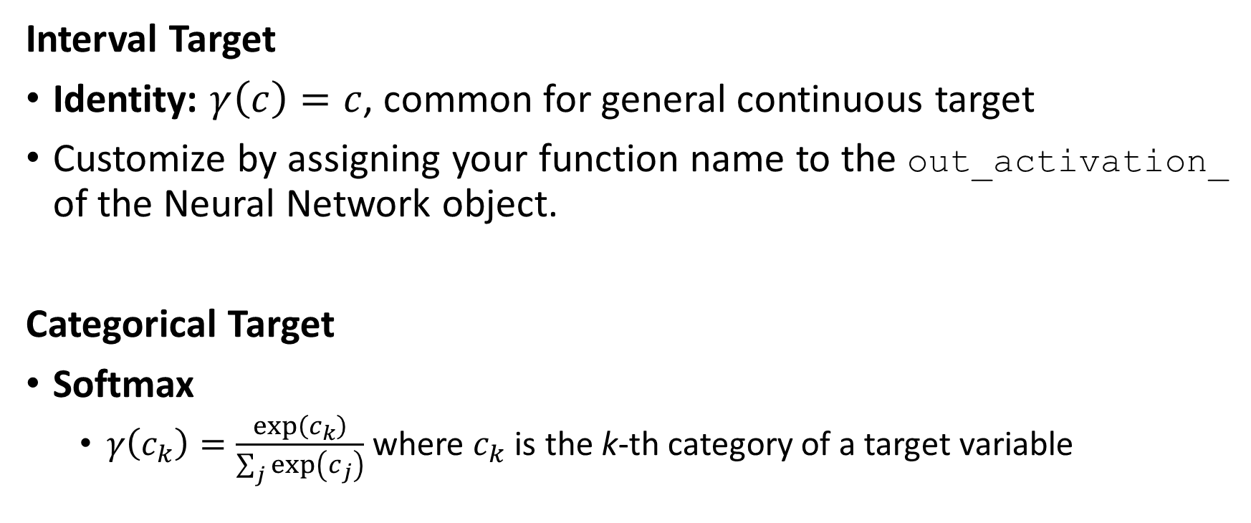
Activation Functions for Output Layer
Interval Target
Identity: $γ\left(c\right)=c$, common for general continuous target
Customize by assigning your function name to the out_activation_ of the Neural Network object.
Categorical Target
Softmax
$γ\left(c_{k}\right)=\frac{exp⁡\left(c_{k}\right)}{\sum_{j}{exp⁡\left(c_{j}\right)}}$ where $c_{k}$ is the k-th category of a target variable

Slide 24
Scaling of input variables
In order to avoid numerical problems in estimation due to differences in magnitudes of input variables, the input variables are usually rescaled before using them in a neural network.
Common methods:
Mid-range – scaled such that the midpoint is 0, the minimum is -1 and the maximum of 1. Formula: y = ((x – x_{min}) – (x_{max} – x))/(x_{max} – x_{min})
Range – scaled such that the minimum is 0 and the maximum is 1. Formula: y = (x – x_{min})/(x_{max} – x_{min})
Standard Deviation – scaled such that the mean is 0 and the standard deviation is 1. Formula: y = (x – x_{mean}) / x_{std}

Slide 25
Scaling of input variables
Categorical input: no scaling is necessary because the values of dummy variables are either 0 or 1.
Interval input:
Use Mid-range or range if the input values are bounded (e.g., age, height)
Use standard deviation for general interval inputs

Slide 26
Back to Our Toy Example
We will conduct a small experiment to see if the accuracy will increase with more layers and more hidden neurons
Activation function is the rectifier, i.e., ReLU function
Maximum number of iterations is 1000
The random state value is 20190403
Scenarios:
1 Hidden Layer, 5 Neurons
1 Hidden Layer, 10 Neurons
2 Hidden Layers, 5 Neurons each
2 Hidden Layers, 10 Neurons each
3 Hidden Layers, 5 Neurons
3 Hidden Layers, 10 Neurons each
Week 12 Toy Neural Network.py

Slide 27
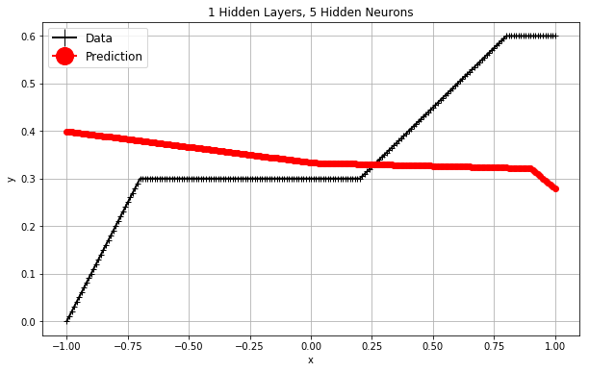
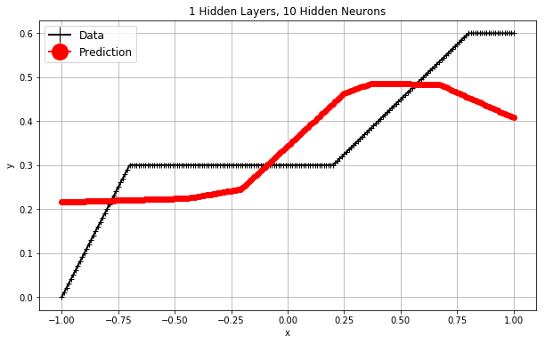
Back to Our Toy Example
Iteration 203, loss = 0.01357496
R^2 = -0.3416 (a bad model!)
Iteration 97, loss = 0.00482815
R^2 = 0.5260

Slide 28
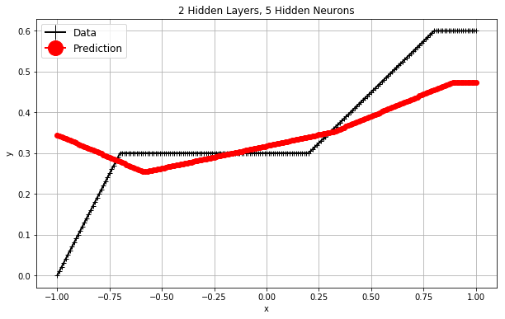
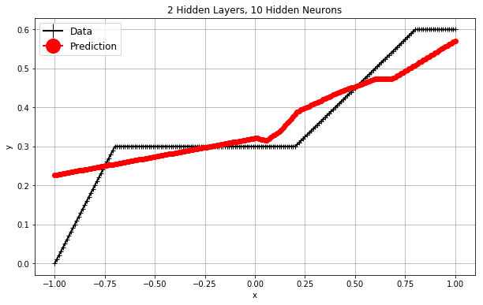
Back to Our Toy Example
Iteration 154, loss = 0.00495702
R^2 = 0.5176
Iteration 60, loss = 0.00208780
R^2 = 0.8053

Slide 29
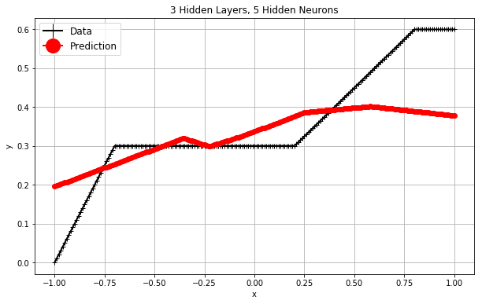
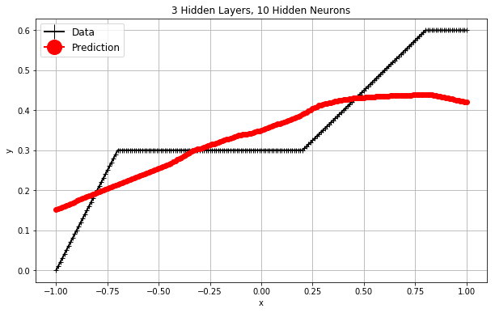
Back to Our Toy Example
Iteration 125, loss = 0.00504436
R^2 = 0.5055
Iteration 50, loss = 0.00351386
R^2 = 0.6590

Slide 30
Back to Our Toy Example
N Layer | N Hidden Nodes | Iteration | Loss | R^2
1 | 5 | 203 | 0.01357496 | -0.3416
1 | 10 | 97 | 0.00482815 | 0.5260
2 | 5 | 154 | 0.00495702 | 0.5176
2 | 10 | 60 | 0.00208780 | 0.8053
3 | 5 | 125 | 0.00504436 | 0.5055
3 | 10 | 50 | 0.00351386 | 0.6590
Preliminary Findings
More hidden nodes per layer may yield lower loss and higher R^2
More hidden layers may not yield better results

Slide 31
Back to Our Toy Example
N Layer | N Hidden Nodes | Iteration | Loss | R^2
2 | 10 | 60 | 0.00208780 | 0.8053
2 | 11 | 116 | 0.00448103 | 0.5621
2 | 12 | 29 | 0.00296255 | 0.7121
2 | 13 | 84 | 0.00177497 | 0.8291
2 | 14 | 119 | 0.00291183 | 0.7207
2 | 15 | 31 | 0.00177558 | 0.8255
2 | 16 | 16 | 0.00193214 | 0.8123
2 | 17 | 35 | 0.00258902 | 0.7479
2 | 18 | 11 | 0.00318083 | 0.6819
2 | 19 | 35 | 0.00261462 | 0.7425
2 | 20 | 27 | 0.00230298 | 0.7746

Slide 32
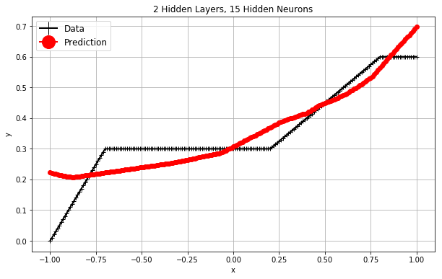
Back to Our Toy Example
Conclusion
It is a trial-and-error process to find the right scenario of the number of layers, the number of hidden nodes, and the activation function

Slide 33
Estimating the Parameters
Input layer:
Number of units = $J_{0}$
Units: ${a_{0;0},a}_{0;1},…,a_{0;J_{0}}$ where $a_{0;0}$ is the bias unit
The $i^{th}$hidden layer ($i=1,…,I−1$):
Number of units = $J_{i}$
Units: $a_{i;1},…,a_{i;J_{i}}$ with $a_{i;k}=γ_{i}\left(c_{i;k}\right)$ and $c_{i;k}=w_{i;0}+\sum_{j=1}^{J_{i−1}}{w_{i;j}a_{i−1;j}}$ where $w_{i;j}$ are the weight coming from the unit $a_{i−1;j}$
Output layer:
Number of units = $J_{I}$
Units: $a_{I;1},…,a_{I;J_{I}}$ with $a_{I;k}=γ_{I}\left(c_{I;k}\right)$ and $c_{I;k}=w_{I;0}+\sum_{j=1}^{J_{I−1}}{w_{I;j}a_{I−1;j}}$ where $w_{I;j}$ are the weight coming from the unit $a_{I−1;j}$

Slide 34
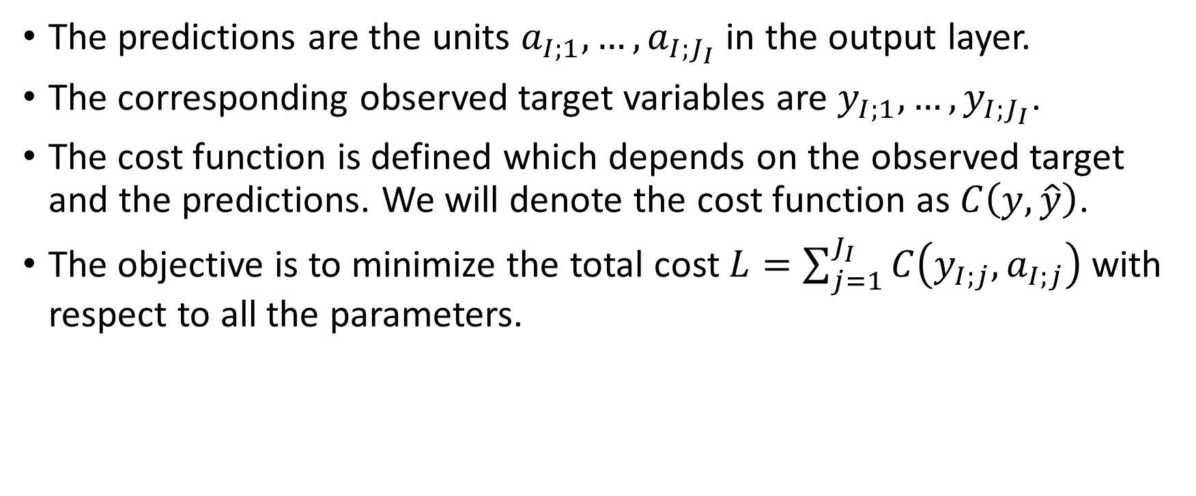
The Cost Function
The predictions are the units $a_{I;1},…,a_{I;J_{I}}$ in the output layer.
The corresponding observed target variables are $y_{I;1},…,y_{I;J_{I}}$.
The cost function is defined which depends on the observed target and the predictions. We will denote the cost function as $C\left(y,\hat{y}\right)$.
The objective is to minimize the total cost $L=\sum_{j=1}^{J_{I}}{C\left(y_{I;j},a_{I;j}\right)}$ with respect to all the parameters.

Slide 35
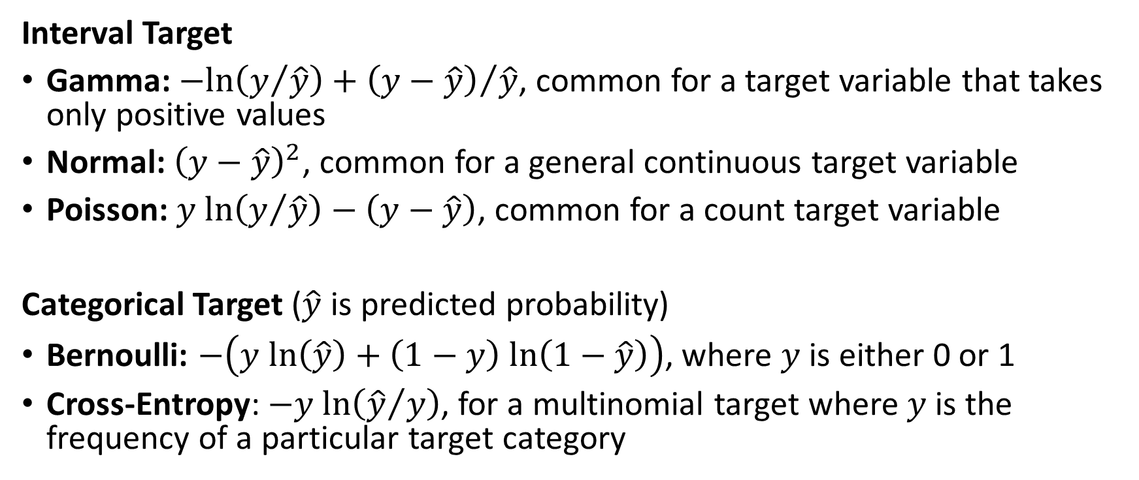
Common Cost Function
Interval Target
Gamma: $−ln\left(y/{\hat{y}}\right)+{\left(y−\hat{y}\right)}/{\hat{y}}$, common for a target variable that takes only positive values
Normal: ${\left(y−\hat{y}\right)}^{2}$, common for a general continuous target variable
Poisson: $y ln\left(y/{\hat{y}}\right)−\left(y−\hat{y}\right)$, common for a count target variable
Categorical Target ($\hat{y}$ is predicted probability)
Bernoulli: $−\left(y ln\left(\hat{y}\right)+\left(1−y\right) ln\left(1−\hat{y}\right)\right)$, where $y$ is either 0 or 1
Cross-Entropy: $−y ln\left({\hat{y}}/y\right)$, for a multinomial target where $y$ is the frequency of a particular target category

Slide 36

Minimize the Total Cost Function
Denote $w=\left(w_{i;j}\right)$ as the vector of all parameters.
Our task is to minimize the total cost $L≡L\left(w\right)$ with respect to $w$.
The necessary condition for the $L\left(w\right)$ attains its minimum at $w=\hat{w}$ is that $∇L\left(\hat{w}\right)=0$ where $∇L$is the gradient of the total cost function.

Slide 37
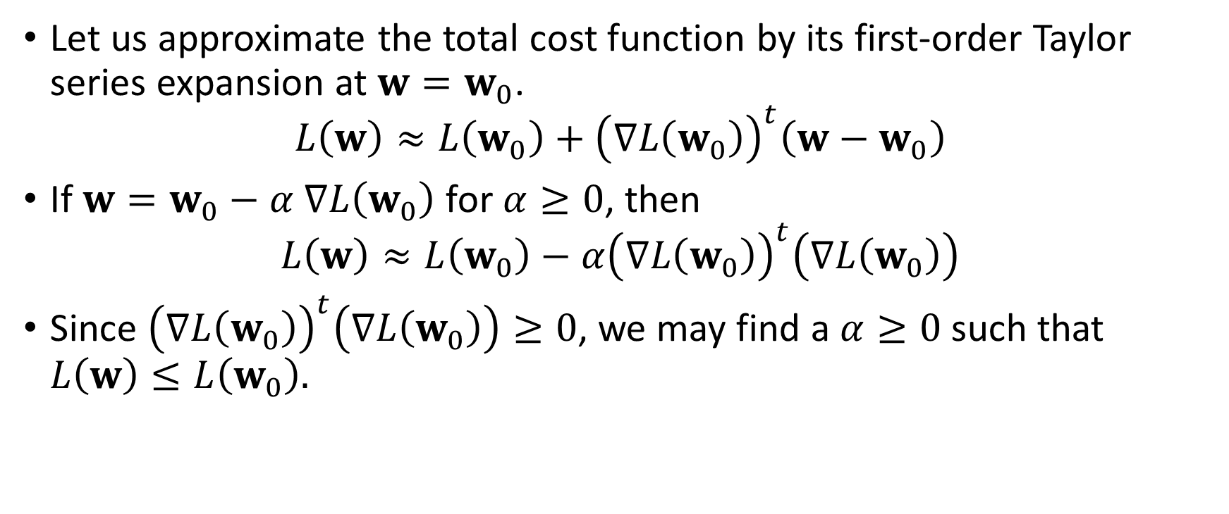
The Gradient Descent Method
Let us approximate the total cost function by its first-order Taylor series expansion at $w=w_{0}$.
$$L\left(w\right)≈L\left(w_{0}\right)+{\left(∇L\left(w_{0}\right)\right)}^{t}\left(w−w_{0}\right)$$
If $w=w_{0}−α$ $∇L\left(w_{0}\right)$ for $α≥0$, then
$$L\left(w\right)≈L\left(w_{0}\right)−α{\left(∇L\left(w_{0}\right)\right)}^{t}\left(∇L\left(w_{0}\right)\right)$$
Since ${\left(∇L\left(w_{0}\right)\right)}^{t}\left(∇L\left(w_{0}\right)\right)≥0$, we may find a $α≥0$ such that $L\left(w\right)≤L\left(w_{0}\right).$

Slide 38
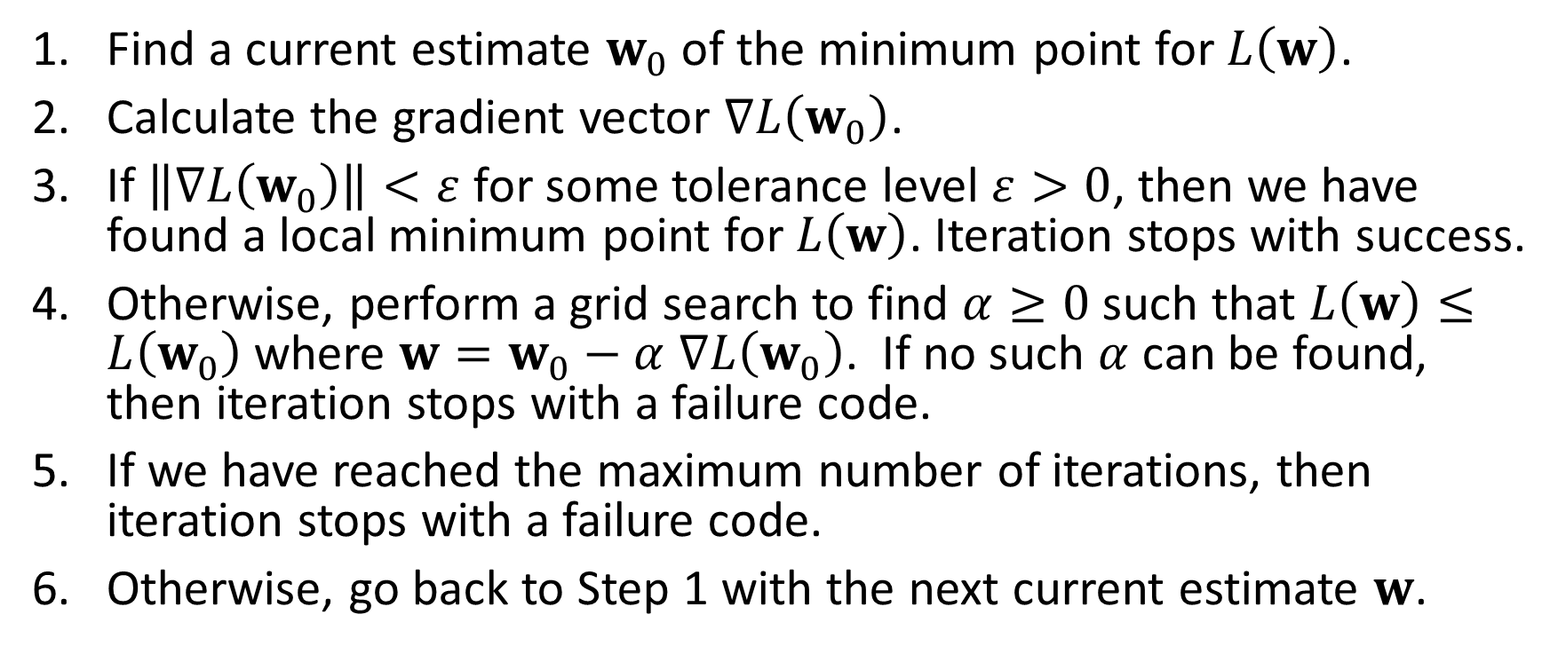
The Gradient Descent Method
Find a current estimate $w_{0}$of the minimum point for $L\left(w\right)$.
Calculate the gradient vector $∇L\left(w_{0}\right)$.
If $\left\|∇L\left(w_{0}\right)\right\|<ε$ for some tolerance level $ε>0$, then we have found a local minimum point for $L\left(w\right)$. Iteration stops with success.
Otherwise, perform a grid search to find $α≥0$ such that $L\left(w\right)≤L\left(w_{0}\right)$ where $w=w_{0}−α$ $∇L\left(w_{0}\right)$. If no such $α$ can be found, then iteration stops with a failure code.
If we have reached the maximum number of iterations, then iteration stops with a failure code.
Otherwise, go back to Step 1 with the next current estimate $w$.

Slide 39
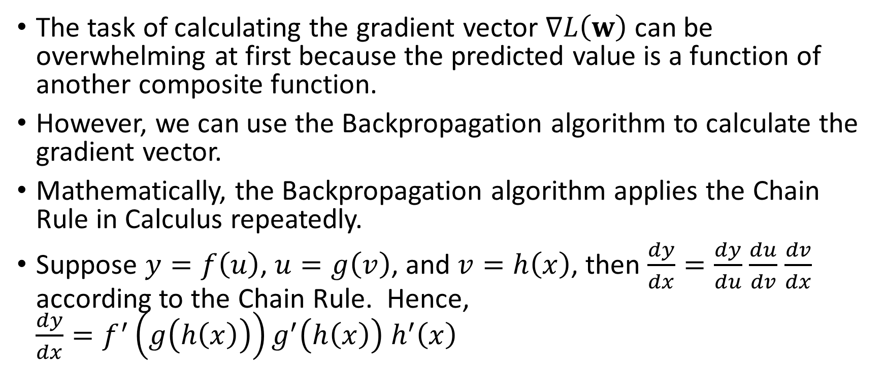
Calculating the Gradient Vector
The task of calculating the gradient vector $∇L\left(w\right)$ can be overwhelming at first because the predicted value is a function of another composite function.
However, we can use the Backpropagation algorithm to calculate the gradient vector.
Mathematically, the Backpropagation algorithm applies the Chain Rule in Calculus repeatedly.
Suppose $y=f\left(u\right)$, $u=g\left(v\right)$, and $v=h\left(x\right)$, then $\frac{dy}{dx}=\frac{dy}{du}$ $\frac{du}{dv}$ $\frac{dv}{dx}$ according to the Chain Rule. Hence, $\frac{dy}{dx}=f^{′}\left(g\left(h\left(x\right)\right)\right)g^{′}\left(h\left(x\right)\right)$ $h^{′}\left(x\right)$

Slide 40
Illustration Using this Neural Network
Bias
Y1
H(2:0)
H(1:0)
H(3:0)
X1
H(2:1)
Y2
X2
H(1:1)
H(3:1)
H(2:2)
Y3
X3
Input Layer
Hidden Layer(s)
Output Layer

Slide 41
Backpropagation Algorithm Illustration
X₀
y₁
h₂₀
h₁₀
h₃₀
x₁
h₂₁
y₂
x₂
h₁₁
h₃₁
h₂₂
y₃
x₃
Input Layer
Hidden Layer(s)
Output Layer

Slide 42
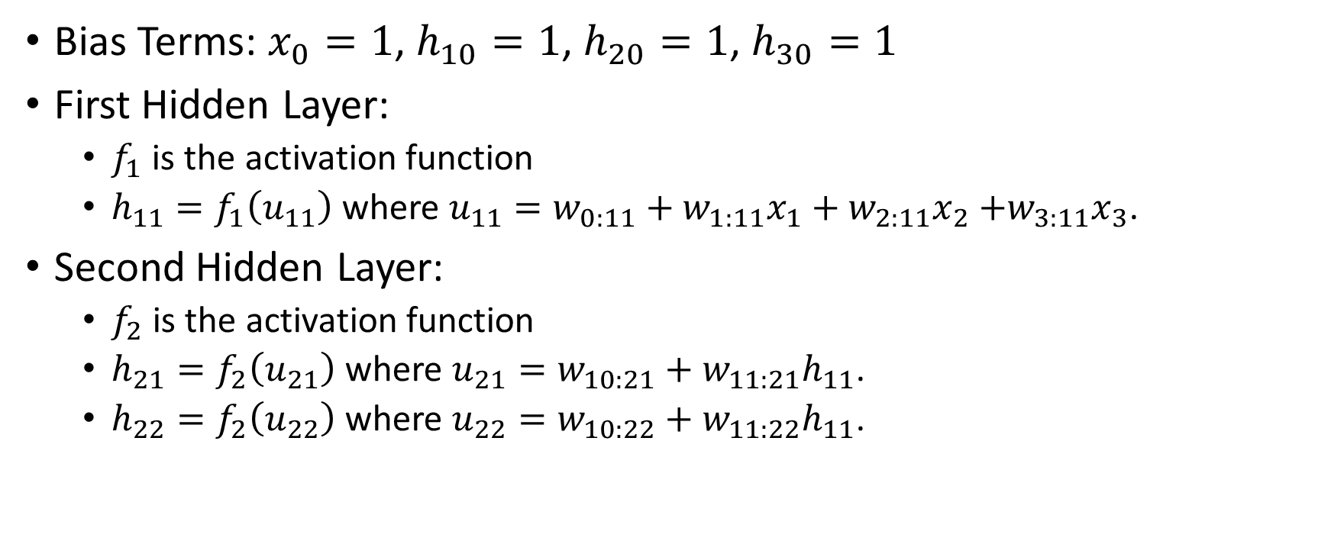
Backpropagation Algorithm Illustration
Bias Terms: $x_{0}=1$, $h_{10}=1$, $h_{20}=1$, $h_{30}=1$
First Hidden Layer:
$f_{1}$ is the activation function
$h_{11}=f_{1}\left(u_{11}\right)$ where $u_{11}=w_{0:11}+w_{1:11}x_{1}+w_{2:11}x_{2}$ $+w_{3:11}x_{3}$.
Second Hidden Layer:
$f_{2}$ is the activation function
$h_{21}=f_{2}\left(u_{21}\right)$ where $u_{21}=w_{10:21}+w_{11:21}h_{11}$.
$h_{22}=f_{2}\left(u_{22}\right)$ where $u_{22}=w_{10:22}+w_{11:22}h_{11}$.

Slide 43
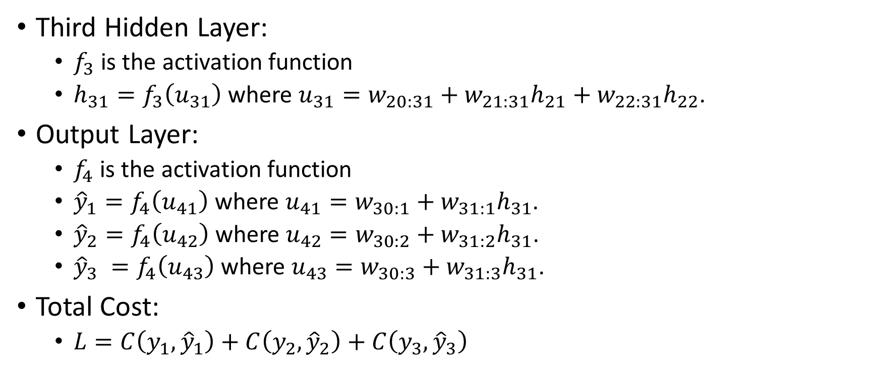
Backpropagation Algorithm Illustration
Third Hidden Layer:
$f_{3}$ is the activation function
$h_{31}=f_{3}\left(u_{31}\right)$ where $u_{31}=w_{20:31}+w_{21:31}h_{21}+w_{22:31}h_{22}$.
Output Layer:
$f_{4}$ is the activation function
${\hat{y}}_{1}=f_{4}\left(u_{41}\right)$ where $u_{41}=w_{30:1}+w_{31:1}h_{31}$.
${\hat{y}}_{2}=f_{4}\left(u_{42}\right)$ where $u_{42}=w_{30:2}+w_{31:2}h_{31}$.
${\hat{y}}_{3} =f_{4}\left(u_{43}\right)$ where $u_{43}=w_{30:3}+w_{31:3}h_{31}$.
Total Cost:
$L=C\left(y_{1},{\hat{y}}_{1}\right)+C\left(y_{2},{\hat{y}}_{2}\right)+C\left(y_{3},{\hat{y}}_{3}\right)$

Slide 44
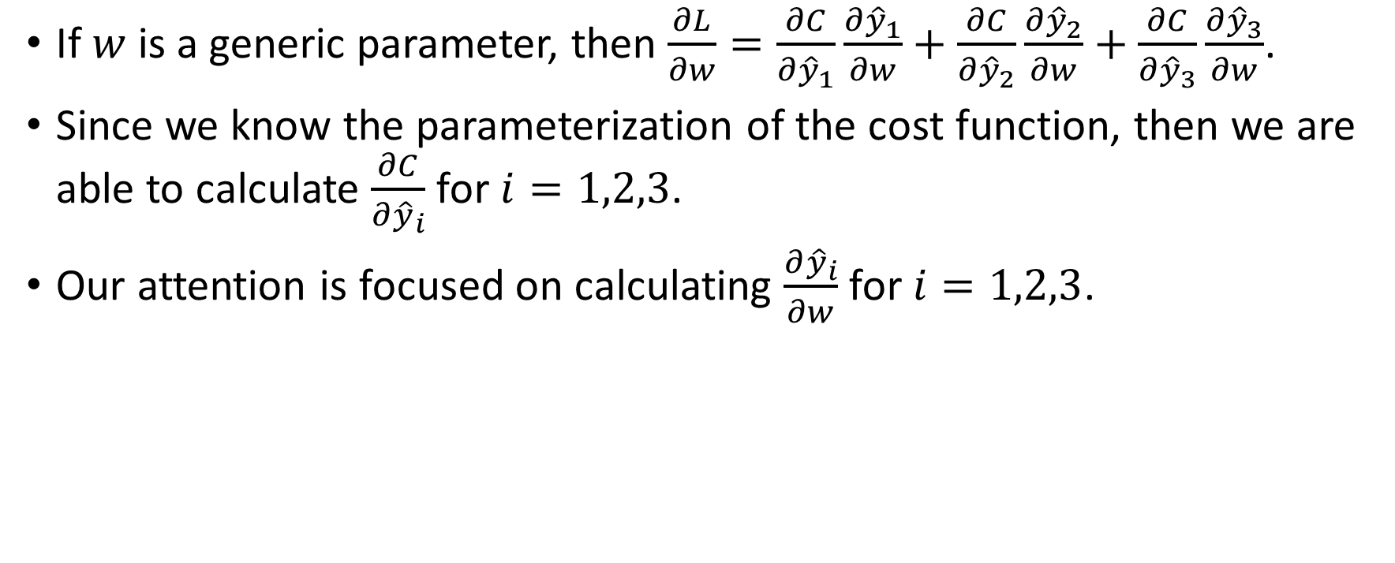
Backpropagation Algorithm Illustration
If $w$ is a generic parameter, then $\frac{∂L}{∂w}=\frac{∂C}{∂{\hat{y}}_{1}}\frac{∂{\hat{y}}_{1}}{∂w}+\frac{∂C}{∂{\hat{y}}_{2}}\frac{∂{\hat{y}}_{2}}{∂w}+\frac{∂C}{∂{\hat{y}}_{3}}\frac{∂{\hat{y}}_{3}}{∂w}$.
Since we know the parameterization of the cost function, then we are able to calculate $\frac{∂C}{∂{\hat{y}}_{i}}$ for $i=1,2,3$.
Our attention is focused on calculating $\frac{∂{\hat{y}}_{i}}{∂w}$ for $i=1,2,3$.

Slide 45
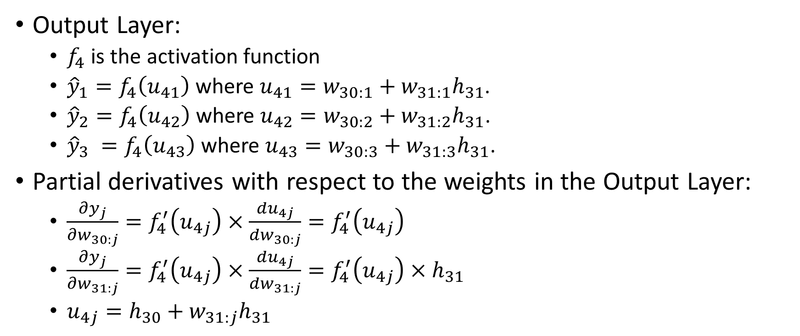
Backpropagation Algorithm Illustration
Output Layer:
$f_{4}$ is the activation function
${\hat{y}}_{1}=f_{4}\left(u_{41}\right)$ where $u_{41}=w_{30:1}+w_{31:1}h_{31}$.
${\hat{y}}_{2}=f_{4}\left(u_{42}\right)$ where $u_{42}=w_{30:2}+w_{31:2}h_{31}$.
${\hat{y}}_{3} =f_{4}\left(u_{43}\right)$ where $u_{43}=w_{30:3}+w_{31:3}h_{31}$.
Partial derivatives with respect to the weights in the Output Layer:
$\frac{∂y_{j}}{∂w_{30:j}}=f_{4}^{′}\left(u_{4j}\right)×\frac{du_{4j}}{dw_{30:j}}=f_{4}^{′}\left(u_{4j}\right)$
$\frac{∂y_{j}}{∂w_{31:j}}=f_{4}^{′}\left(u_{4j}\right)×\frac{du_{4j}}{dw_{31:j}}=f_{4}^{′}\left(u_{4j}\right)×h_{31}$
$u_{4j}=h_{30}+w_{31:j}h_{31}$

Slide 46
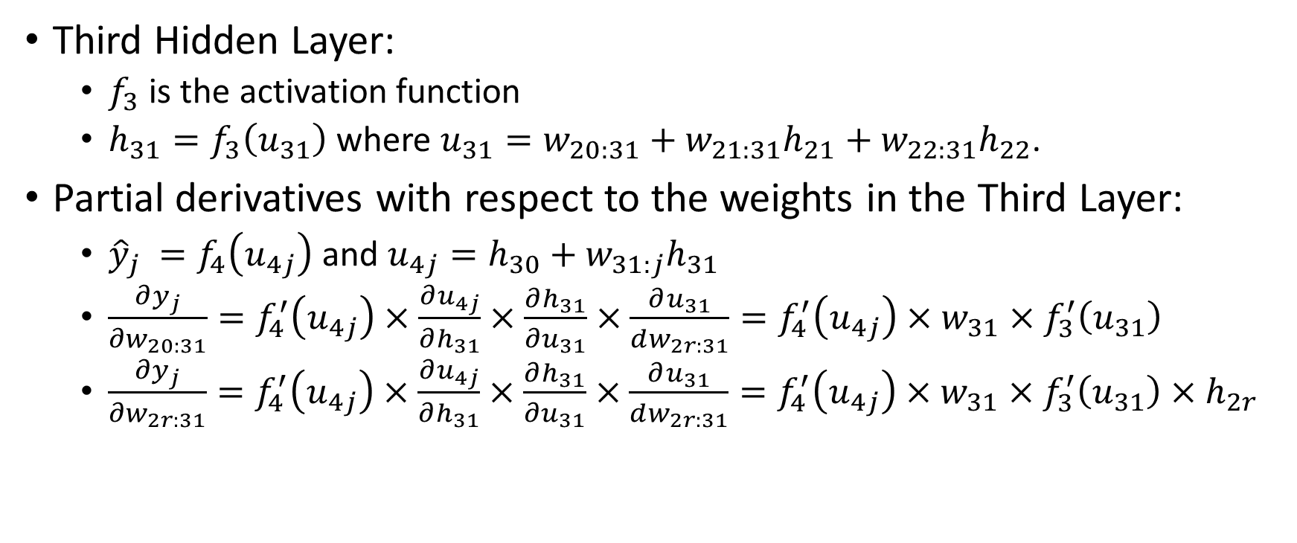
Backpropagation Algorithm Illustration
Third Hidden Layer:
$f_{3}$ is the activation function
$h_{31}=f_{3}\left(u_{31}\right)$ where $u_{31}=w_{20:31}+w_{21:31}h_{21}+w_{22:31}h_{22}$.
Partial derivatives with respect to the weights in the Third Layer:
${\hat{y}}_{j} =f_{4}\left(u_{4j}\right)$ and $u_{4j}=h_{30}+w_{31:j}h_{31}$
$\frac{∂y_{j}}{∂w_{20:31}}=f_{4}^{′}\left(u_{4j}\right)×\frac{∂u_{4j}}{∂h_{31}}×\frac{∂h_{31}}{∂u_{31}}×\frac{∂u_{31}}{dw_{2r:31}}=f_{4}^{′}\left(u_{4j}\right)×w_{31}×f_{3}^{′}\left(u_{31}\right)$
$\frac{∂y_{j}}{∂w_{2r:31}}=f_{4}^{′}\left(u_{4j}\right)×\frac{∂u_{4j}}{∂h_{31}}×\frac{∂h_{31}}{∂u_{31}}×\frac{∂u_{31}}{dw_{2r:31}}=f_{4}^{′}\left(u_{4j}\right)×w_{31}×f_{3}^{′}\left(u_{31}\right)×h_{2r}$

Slide 47
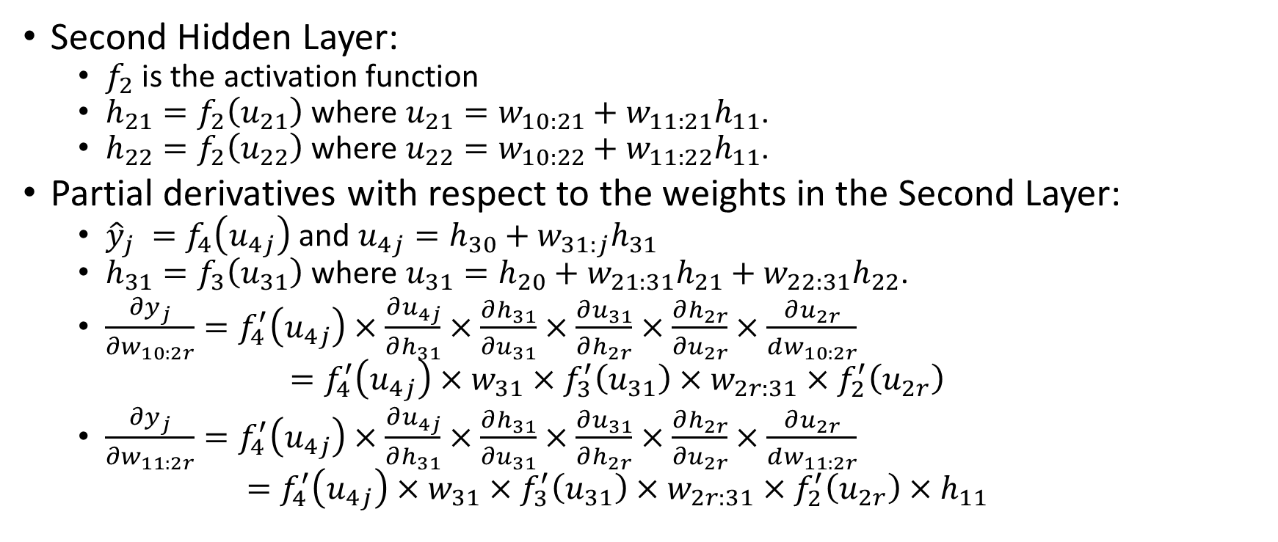
Backpropagation Algorithm Illustration
Second Hidden Layer:
$f_{2}$ is the activation function
$h_{21}=f_{2}\left(u_{21}\right)$ where $u_{21}=w_{10:21}+w_{11:21}h_{11}$.
$h_{22}=f_{2}\left(u_{22}\right)$ where $u_{22}=w_{10:22}+w_{11:22}h_{11}$.
Partial derivatives with respect to the weights in the Second Layer:
${\hat{y}}_{j} =f_{4}\left(u_{4j}\right)$ and $u_{4j}=h_{30}+w_{31:j}h_{31}$
$h_{31}=f_{3}\left(u_{31}\right)$ where $u_{31}=h_{20}+w_{21:31}h_{21}+w_{22:31}h_{22}$.
$\frac{∂y_{j}}{∂w_{10:2r}}=f_{4}^{′}\left(u_{4j}\right)×\frac{∂u_{4j}}{∂h_{31}}×\frac{∂h_{31}}{∂u_{31}}×\frac{∂u_{31}}{∂h_{2r}}×\frac{∂h_{2r}}{∂u_{2r}}×\frac{∂u_{2r}}{dw_{10:2r}}$ $=f_{4}^{′}\left(u_{4j}\right)×w_{31}×f_{3}^{′}\left(u_{31}\right)×w_{2r:31}×f_{2}^{′}\left(u_{2r}\right)$
$\frac{∂y_{j}}{∂w_{11:2r}}=f_{4}^{′}\left(u_{4j}\right)×\frac{∂u_{4j}}{∂h_{31}}×\frac{∂h_{31}}{∂u_{31}}×\frac{∂u_{31}}{∂h_{2r}}×\frac{∂h_{2r}}{∂u_{2r}}×\frac{∂u_{2r}}{dw_{11:2r}}$ $=f_{4}^{′}\left(u_{4j}\right)×w_{31}×f_{3}^{′}\left(u_{31}\right)×w_{2r:31}×f_{2}^{′}\left(u_{2r}\right)×h_{11}$

Slide 48
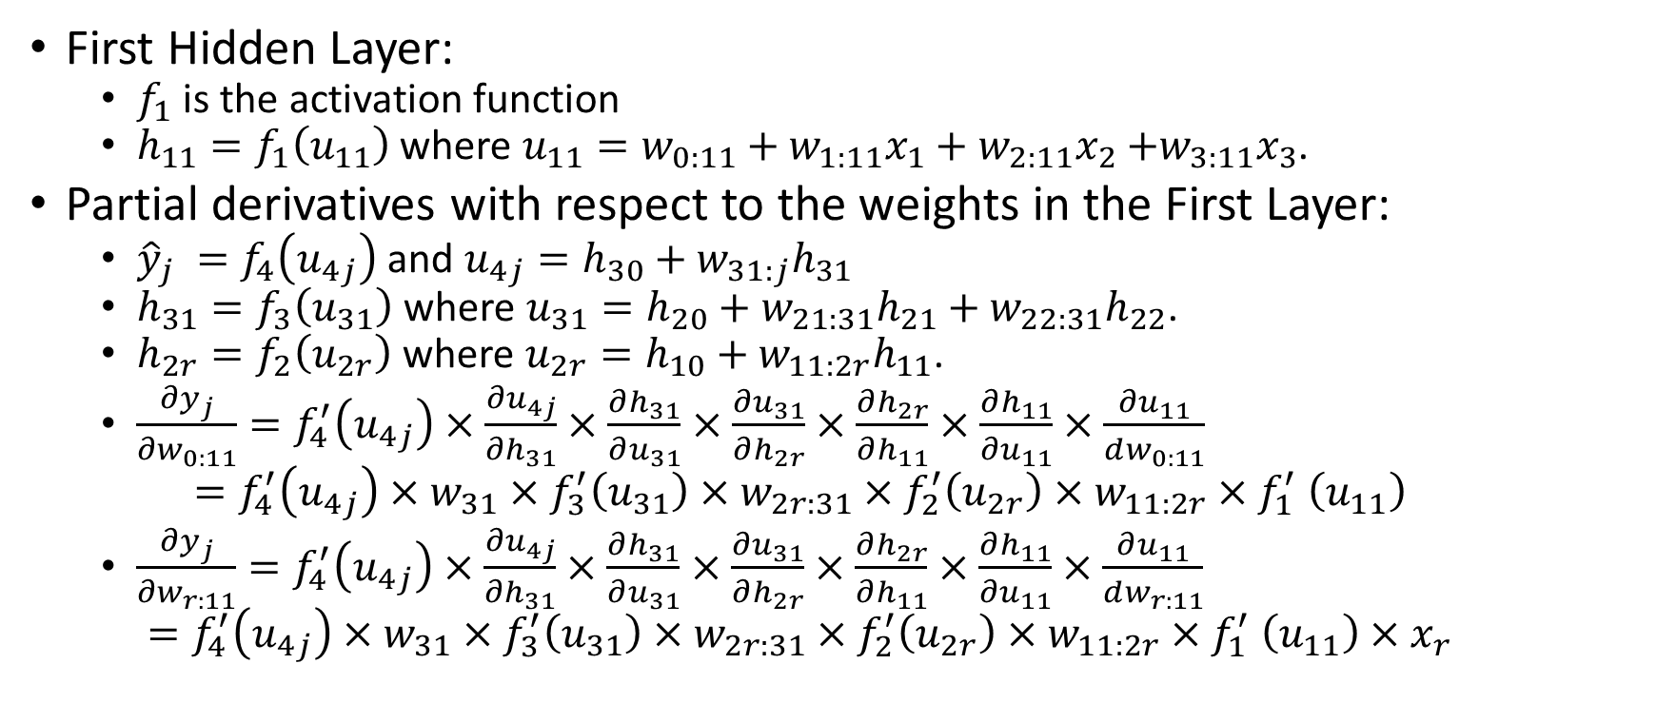
Backpropagation Algorithm Illustration
First Hidden Layer:
$f_{1}$ is the activation function
$h_{11}=f_{1}\left(u_{11}\right)$ where $u_{11}=w_{0:11}+w_{1:11}x_{1}+w_{2:11}x_{2}$ $+w_{3:11}x_{3}$.
Partial derivatives with respect to the weights in the First Layer:
${\hat{y}}_{j} =f_{4}\left(u_{4j}\right)$ and $u_{4j}=h_{30}+w_{31:j}h_{31}$
$h_{31}=f_{3}\left(u_{31}\right)$ where $u_{31}=h_{20}+w_{21:31}h_{21}+w_{22:31}h_{22}$.
$h_{2r}=f_{2}\left(u_{2r}\right)$ where $u_{2r}=h_{10}+w_{11:2r}h_{11}$.
$\frac{∂y_{j}}{∂w_{0:11}}=f_{4}^{′}\left(u_{4j}\right)×\frac{∂u_{4j}}{∂h_{31}}×\frac{∂h_{31}}{∂u_{31}}×\frac{∂u_{31}}{∂h_{2r}}×\frac{∂h_{2r}}{∂h_{11}}×\frac{∂h_{11}}{∂u_{11}}×\frac{∂u_{11}}{dw_{0:11}}$ $=f_{4}^{′}\left(u_{4j}\right)×w_{31}×f_{3}^{′}\left(u_{31}\right)×w_{2r:31}×f_{2}^{′}\left(u_{2r}\right)×w_{11:2r}{×f}_{1}^{′}\left(u_{11}\right)$
$\frac{∂y_{j}}{∂w_{r:11}}=f_{4}^{′}\left(u_{4j}\right)×\frac{∂u_{4j}}{∂h_{31}}×\frac{∂h_{31}}{∂u_{31}}×\frac{∂u_{31}}{∂h_{2r}}×\frac{∂h_{2r}}{∂h_{11}}×\frac{∂h_{11}}{∂u_{11}}×\frac{∂u_{11}}{dw_{r:11}}$ $=f_{4}^{′}\left(u_{4j}\right)×w_{31}×f_{3}^{′}\left(u_{31}\right)×w_{2r:31}×f_{2}^{′}\left(u_{2r}\right)×w_{11:2r}{×f}_{1}^{′}\left(u_{11}\right)×x_{r}$

Slide 49
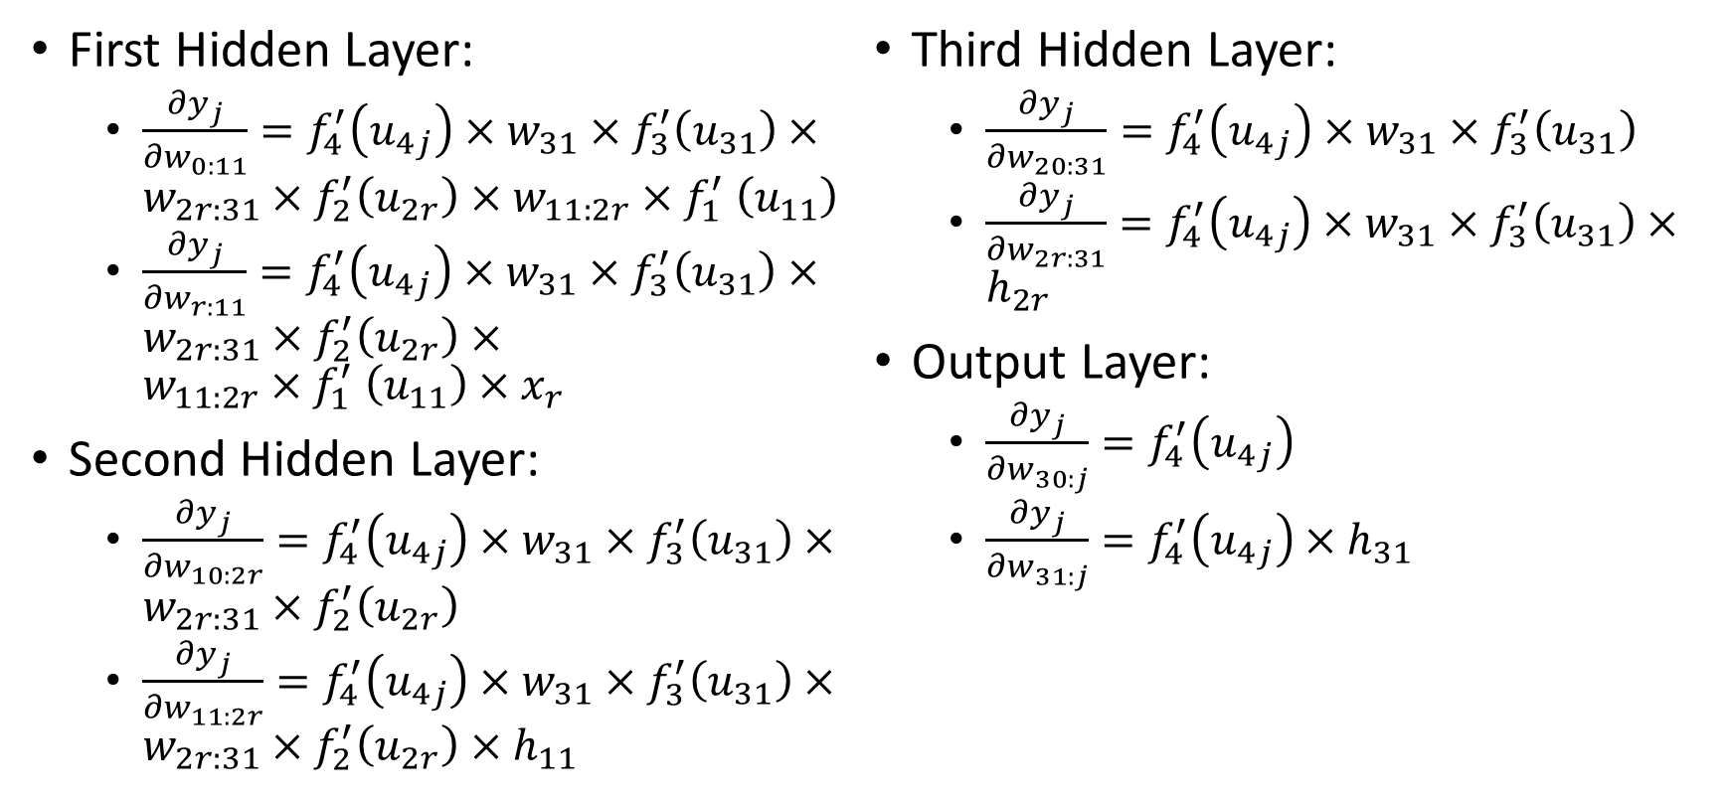
Backpropagation Algorithm Illustration
First Hidden Layer:
$\frac{∂y_{j}}{∂w_{0:11}}=f_{4}^{′}\left(u_{4j}\right)×w_{31}×f_{3}^{′}\left(u_{31}\right)×w_{2r:31}×f_{2}^{′}\left(u_{2r}\right)×w_{11:2r}{×f}_{1}^{′}\left(u_{11}\right)$
$\frac{∂y_{j}}{∂w_{r:11}}=f_{4}^{′}\left(u_{4j}\right)×w_{31}×f_{3}^{′}\left(u_{31}\right)×w_{2r:31}×f_{2}^{′}\left(u_{2r}\right)×w_{11:2r}{×f}_{1}^{′}\left(u_{11}\right)×x_{r}$
Second Hidden Layer:
$\frac{∂y_{j}}{∂w_{10:2r}}=f_{4}^{′}\left(u_{4j}\right)×w_{31}×f_{3}^{′}\left(u_{31}\right)×w_{2r:31}×f_{2}^{′}\left(u_{2r}\right)$
$\frac{∂y_{j}}{∂w_{11:2r}}=f_{4}^{′}\left(u_{4j}\right)×w_{31}×f_{3}^{′}\left(u_{31}\right)×w_{2r:31}×f_{2}^{′}\left(u_{2r}\right)×h_{11}$
Third Hidden Layer:
$\frac{∂y_{j}}{∂w_{20:31}}=f_{4}^{′}\left(u_{4j}\right)×w_{31}×f_{3}^{′}\left(u_{31}\right)$
$\frac{∂y_{j}}{∂w_{2r:31}}=f_{4}^{′}\left(u_{4j}\right)×w_{31}×f_{3}^{′}\left(u_{31}\right)×h_{2r}$
Output Layer:
$\frac{∂y_{j}}{∂w_{30:j}}=f_{4}^{′}\left(u_{4j}\right)$
$\frac{∂y_{j}}{∂w_{31:j}}=f_{4}^{′}\left(u_{4j}\right)×h_{31}$

Slide 50
Backpropagation Algorithm Illustration
The partial derivatives in a layer depend on the
Values of the hidden nodes of the current layer and the subsequent layers
Values of the weights of the subsequent layers.
The algorithm is to update the partial derivatives from the Output Layer, and then work its way back to the First Hidden Layer.

Slide 51
Backpropagation Algorithm Illustration
For current estimates of the weights
Perform a feedforward scoring of the neural network to get the predictions.
Calculate the partial derivatives in the Output Layer, update the weights in that layer using the gradient descent method.
Calculate the partial derivatives in the Third Hidden Layer, update the weights in that layer using the gradient descent method.
Calculate the partial derivatives in the Second Hidden Layer, update the weights in that layer using the gradient descent method.
Calculate the partial derivatives in the First Hidden Layer, update the weights in that layer using the gradient descent method.
Repeat Step 1 to 6 until convergence.

Slide 52
SKLEARN Functions
sklearn.neural_network.MLPClassifier for categorical target variable.
sklearn.neural_network.MLPRegressor for interval target variable.

Slide 53
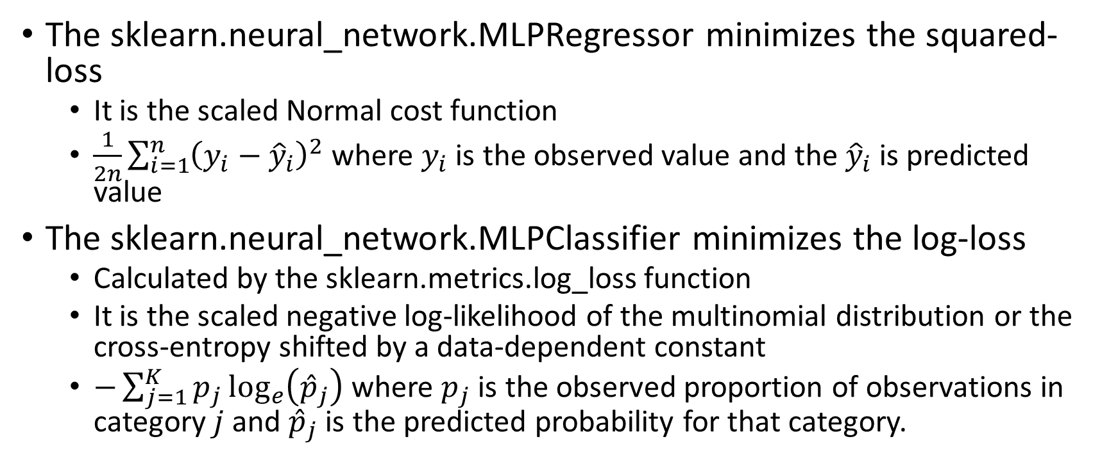
Cost Function in sklearn.neural_network
The sklearn.neural_network.MLPRegressor minimizes the squared-loss
It is the scaled Normal cost function
$\frac{1}{2n}\sum_{i=1}^{n}{{\left(y_{i}−{\hat{y}}_{i}\right)}^{2}}$ where $y_{i}$ is the observed value and the ${\hat{y}}_{i}$ is predicted value
The sklearn.neural_network.MLPClassifier minimizes the log-loss
Calculated by the sklearn.metrics.log_loss function
It is the scaled negative log-likelihood of the multinomial distribution or the cross-entropy shifted by a data-dependent constant
$−\sum_{j=1}^{K}{p_{j}\log_{e}\left({\hat{p}}_{j}\right)}$ where $p_{j}$ is the observed proportion of observations in category $j$ and ${\hat{p}}_{j}$ is the predicted probability for that category.

Slide 54
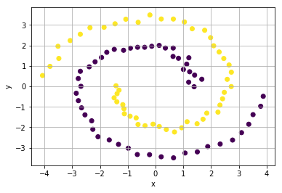
Classification Using Neural Network
Let us use Neural Network to classify the two spirals which we saw in Assignment 2.
Week 12 Spiral Neural Network.py

Slide 55
Classification Using Neural Network
Activation function is the hyperbolic tangent.
Maximum number of iterations is 10,000
Random state value is 60616
Scenarios
Number of layers = 1 and 2
Number of neurons = 1, 3, 5, 10
Output Activation Function: logistic
Week 12 Spiral Neural Network.py

Slide 56
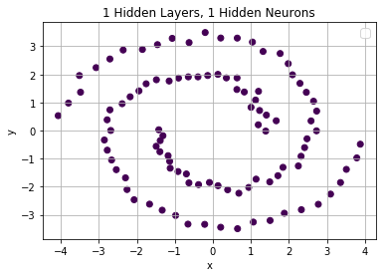
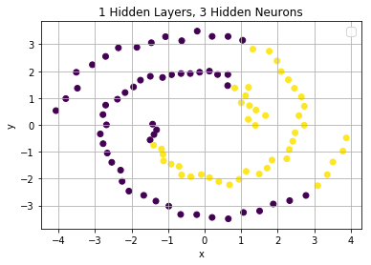
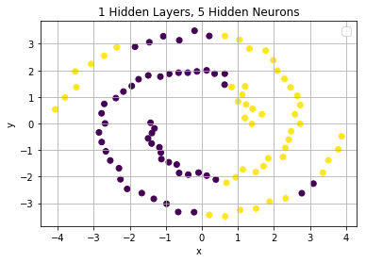
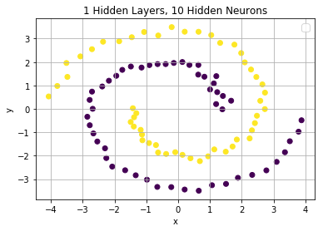
Classification Using Neural Network
N Layer | N Hidden Nodes | Iteration | Log-Loss | Mean Accuracy
1 | 1 | 968 | 0.72875689 | 0.5
1 | 3 | 319 | 0.66385296 | 0.67
1 | 5 | 573 | 0.68313541 | 0.6
1 | 10 | 2959 | 0.15217613 | 1.0

Slide 57
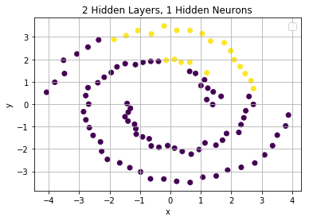
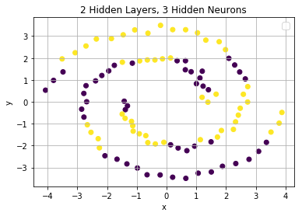
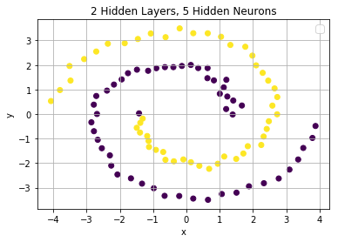
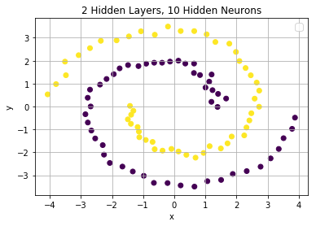
Classification Using Neural Network
N Layer | N Hidden Nodes | Iteration | Log-Loss | Mean Accuracy
2 | 1 | 351 | 0.66591589 | 0.61
2 | 3 | 856 | 0.56105096 | 0.69
2 | 5 | 1478 | 0.10060641 | 0.99
2 | 10 | 1272 | 0.04851632 | 1.00

Slide 58
A Few Remarks on Deep Learning
Deep learning is a type of machine learning that trains a computer to perform human-like tasks, such as recognizing speech, identifying images or making predictions.
Instead of organizing data to run through predefined equations, deep learning sets up basic parameters about the data and trains the computer to learn on its own by recognizing patterns using many layers of processing.

Slide 59
A Few Words on Deep Learning
Deep learning is a type of machine learning that trains a computer to perform human-like tasks, such as recognizing speech, identifying images or making predictions.
Instead of organizing data to run through predefined equations, deep learning sets up basic parameters about the data and trains the computer to learn on its own by recognizing patterns using many layers of processing.
New classes of neural networks have been developed that fit well for applications like text translation and image classification.

Slide 60
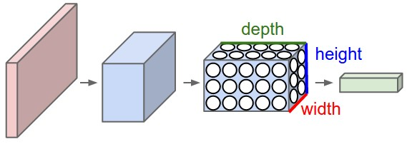
Convolution Neural Networks (CNN)
CNNs are designed to take image data as input.
The layers in a CNN have 3 dimensions: width, height, and depth.
Every layer of a CNN transforms the 3-dimensional input volume to a 3-dimensional output volume of neuron activations.
Credit: http://cs231n.github.io/convolutional-networks/

Slide 61
Recurrent Neural Networks (RNN)
RNN are specifically designed to handle sequence data, such as speech, text, and time series.
RNNs are called recurrent because they perform the same task for every element of a sequence.

Slide 62
Recurrent Neural Networks (RNN)
Forecasting and time series
Input is numeric sequence data
Output is a single numeric value or a nominal target value.
Sentiment analysis and text categorization
Input is text data
Output is a single numeric value or a nominal target value (happiness).
Automatic speech recognition
Input is a numeric sequence (e.g., sound wave characteristics)
Output is nominal labels (e.g., words or phrases) for the input sequence.
Text summarization, and simple question and answer
Input is text (original text).
Output is also text (keywords or concepts).

Slide 63
Assignment 4
Assignment 4 will be posted on Friday, April 5, 2019
Due date is 11:59 pm on Monday, April 15, 2019
Maximum two attempts, only the most recent attempt is graded
Must submit Python codes with the assignment, otherwise the teaching assistant may deduct 50% of your question score
Name your Python codes or Jupyter notebooks as Q1.py or Q1.ipynb

